Slide 1

Project-1: Working with Data
Saurabh Bhardwaj

Slide 2
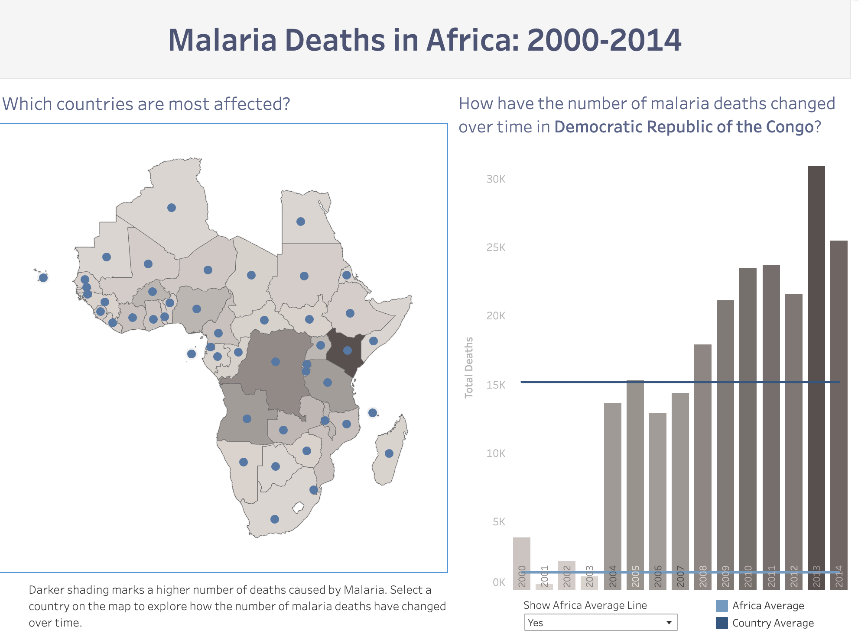
Analyze the three countries where most deaths due to Malaria took place in Africa.
As the darker regions show higher deaths, let’s first analyze Democratic Republic of the Congo.
It is clear from the graph that in Congo, the average deaths are almost 15 times higher than the Africa’s average. Also, the most deaths took place in 2013 which are almost 30K.
It is also important to note that since 2014, the deaths in Congo increased every year except three years 2006, 2012 and 2014.

Slide 3
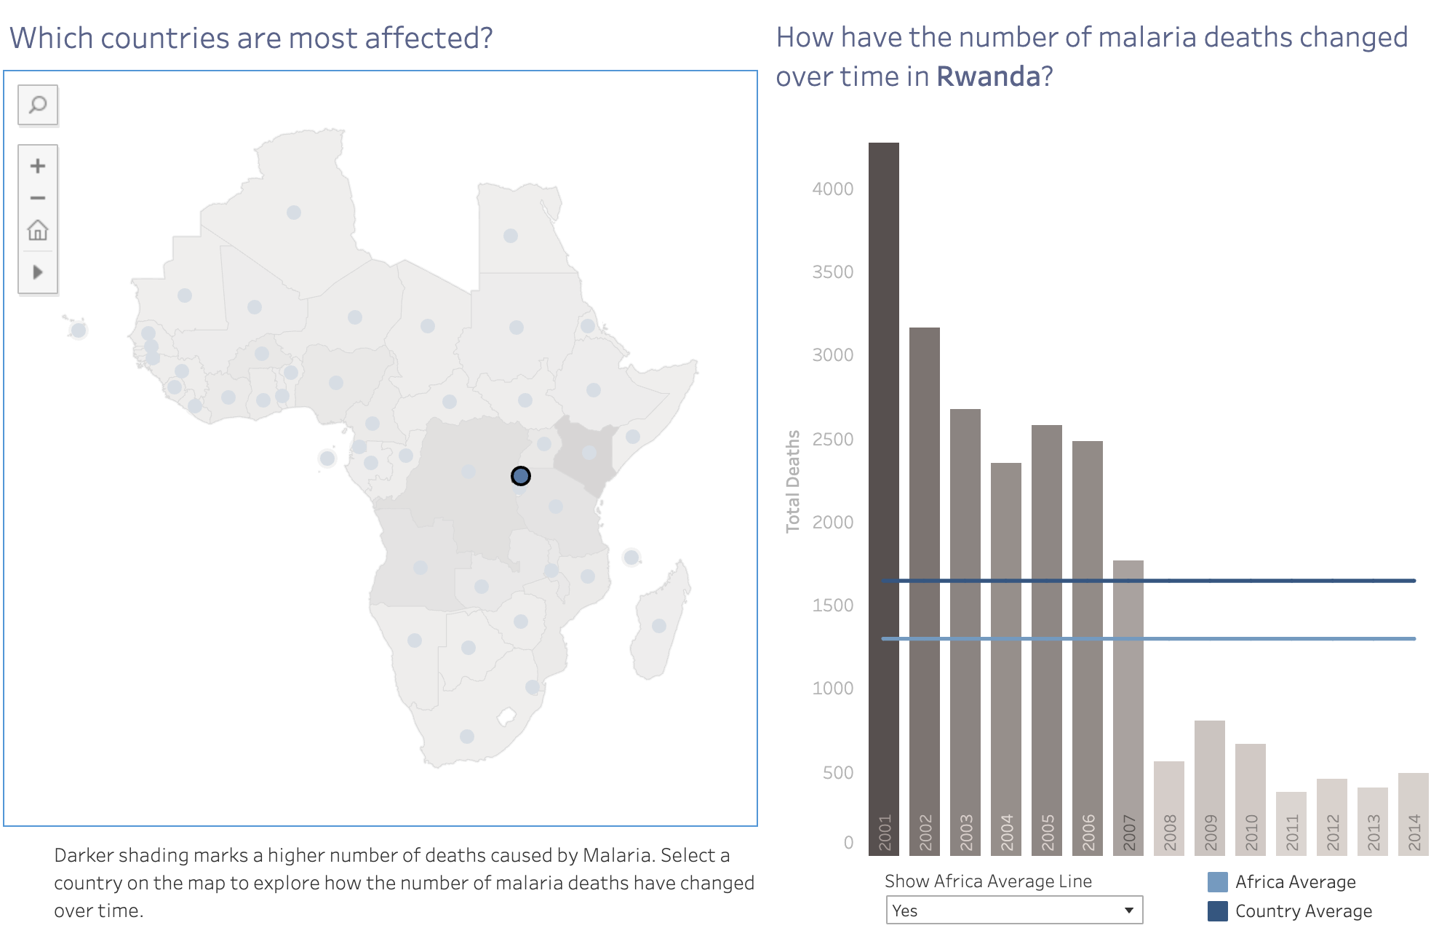
Analyze the three countries where most deaths due to Malaria took place in Africa.
Looking at Rwanda, even though the deaths are just above 4000, it is interesting to note that as oppose to Congo, deaths in Rwanda fallen significantly from 2001to 2014.
It is also worth noting that the average deaths in Rwanda is close in average in Africa.
Another point worth mentioning is that after a huge drop in death in 2008, the deaths per year stayed almost same. Analyzing it can give us more information about what is causing it.

Slide 4
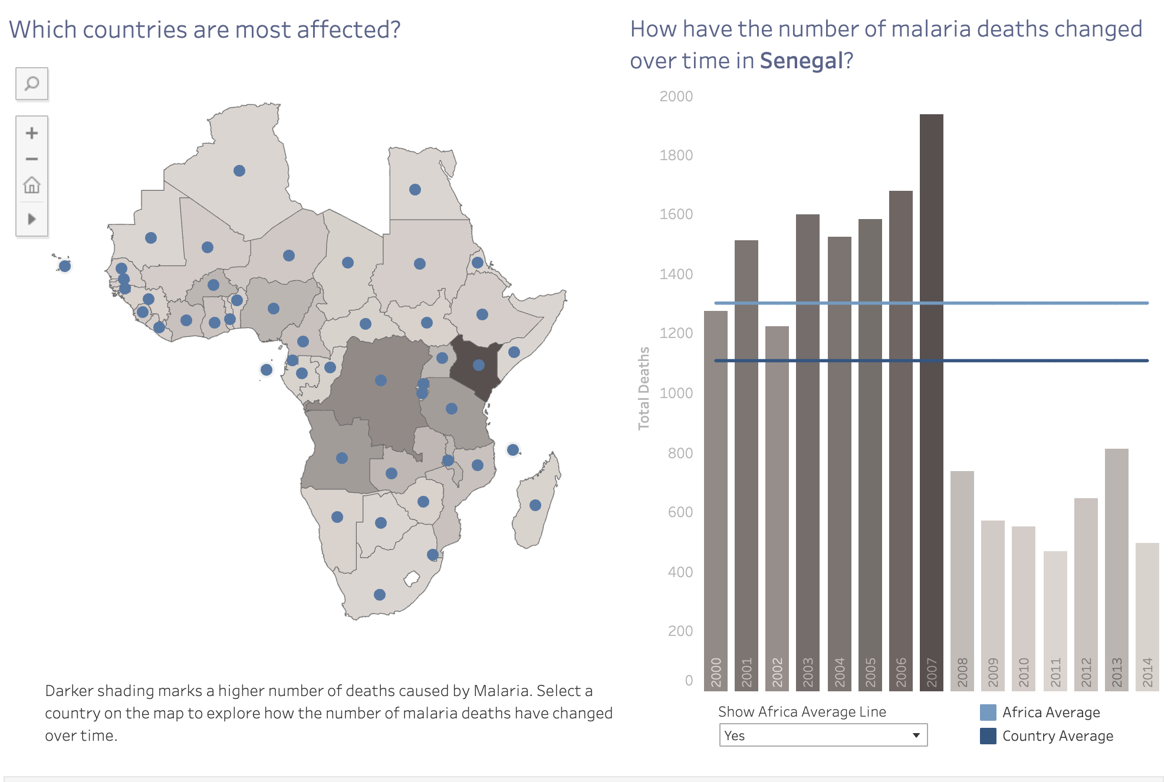
Analyze the three countries where most deaths due to Malaria took place in Africa.
Looking the the Senegal, there was a constant increase in death from 2001 to 2007, but there was a 60% drop in number of death in 2008.
It also remain almost same until 2014 except the two spikes in 2012 and 2013. It an be an important point to understand what caused this drop either to understand the effect of a new medicine or something else.
Average death in Africa is 1300 and in Senegal, it is 1100.

